Slide 1
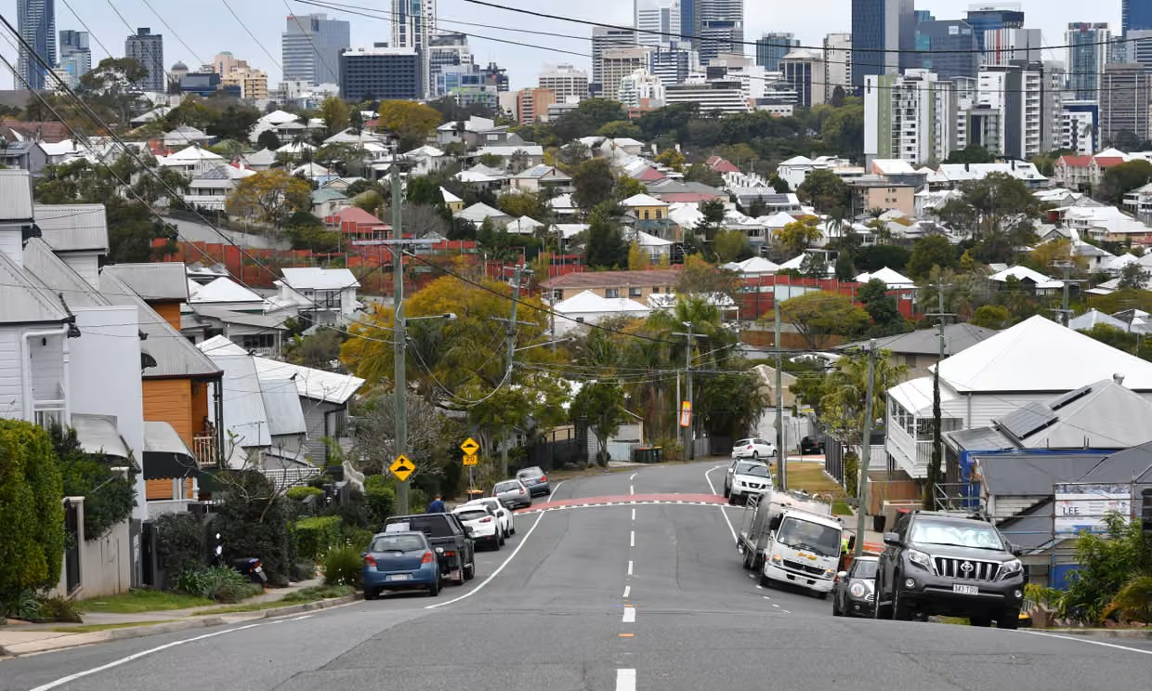


Advocating in challenging times

Slide 2
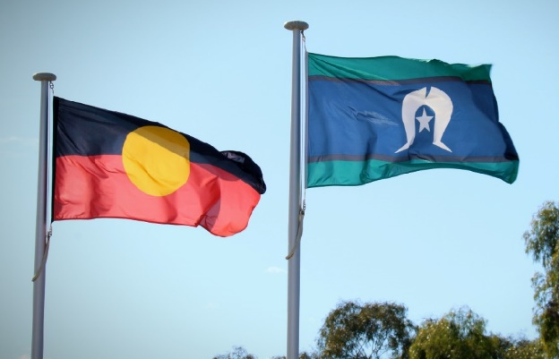
Acknowledgement of Country
I acknowledge the land I am on is stolen and unceded, belonging to the Turrbal and Jagera Peoples.
I pay my respect to community members, leaders and elders – past, present and emerging.
I also want to acknowledge the disproportionate impact of youth homelessness on First Nations young people throughout Australia and its link to dispossession and systemic injustice.

Slide 3
Advocacy is about shifting power to influence decision makers
- in particular:
(1) What funding and policy priorities they set
(2) What pressure they feel to act
(3) What outcomes they believe are possible

Slide 4
Effective advocacy is planned, strategic and disciplined.
It requires a clear purpose, a well-informed theory of change and the tactics to deliver it.

Slide 5
You don’t have to agree with a government to influence it, but you do need to understand it.
Governments don’t fund problems, they fund decisions.
We can change those decisions.

Slide 6
We can learn to adapt our message and our tactics without compromising our values and commitment to young people.
Centring lived experience in our advocacy isn’t a tactic, it’s a responsibility.

Slide 7
All governments are trying to solve problems. These can be policy problems, budget problems, political problems or even personal problems for individual decision makers.
Understanding what problems we can solve or assist with - and what problems we can create or sharpen - is important to understanding our power and influence.

Slide 8
What is driving the Queensland Government?
(1) Community safety and youth crime
(2) Housing supply and home ownership
(3) Health system problems and improvements
(4) Cost of living pressure and household bills
(5) Economic growth and infrastructure

Slide 9
Effective tactics for challenging times:
(1) Coalition building
(2) Community engagement
(3) Place-based approaches and partnerships
(4) Government engagement at every level
(5) Engaging with the Opposition
(6) Re-framing (and testing) our messages
(7) Supporting lived experience advocacy and leadership

Slide 10
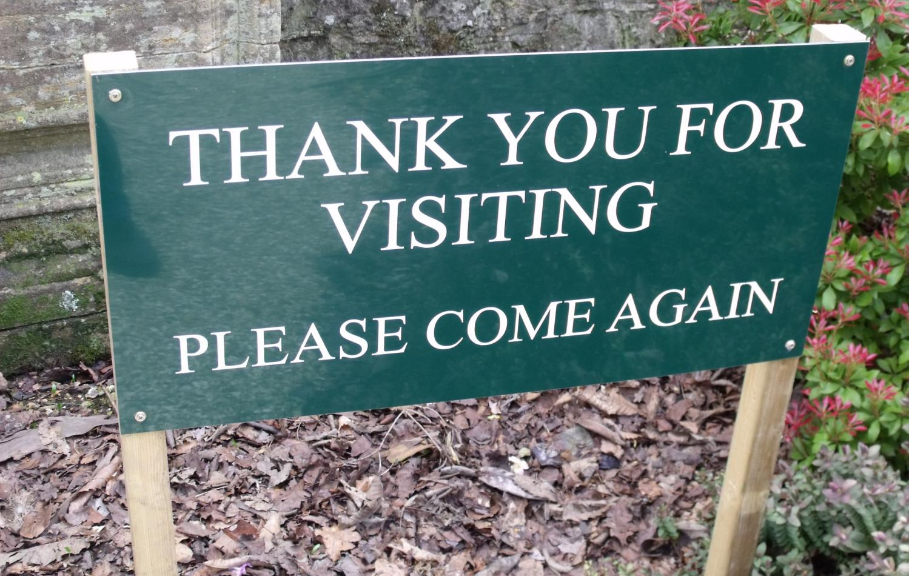
Daniel Scoullar
0402 596 297 / daniel@socialchangeprojects.com.au

