Slide 1




Breaking the cycle of multiplying adversities: How prevalence evidence can drive prevention and transform outcomes for young people.
Platform 1225 Conference
Queensland Youth Housing Coalition
26 March 2026
Lakjfaskldfjkldsfjdsl

Slide 2
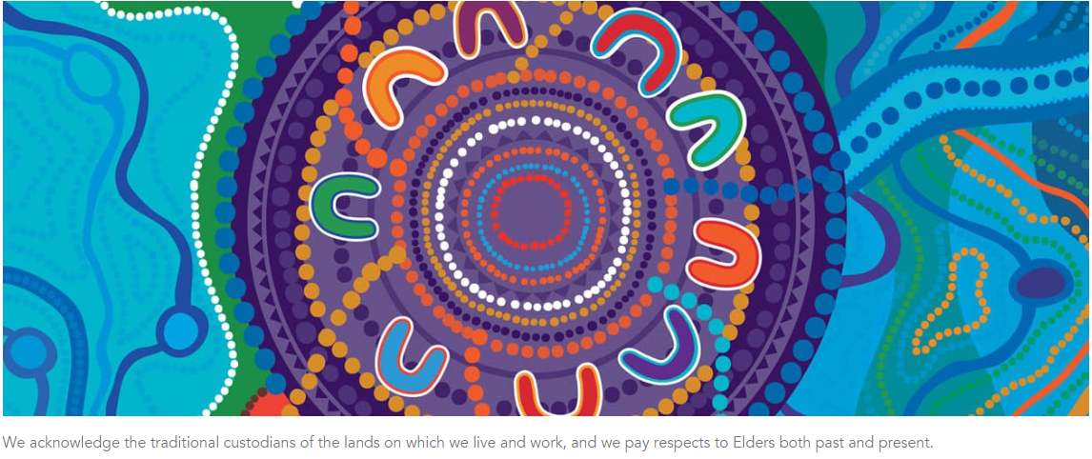

Slide 3
1
Key results from the Australian Child Maltreatment Study (ACMS): prevalence and impact of child maltreatment
For more resources, see:
www.acms.au

Slide 4
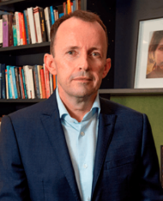




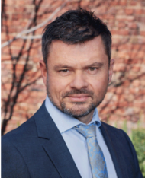
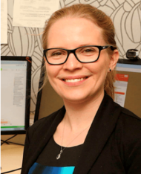




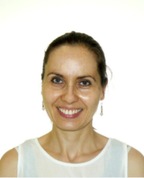
On Behalf of the ACMS team
Distinguished Prof Ben Mathews (QUT)
Prof Rosana Pacella
(Greenwich University)
Prof James Scott (QIMR Berghofer, QCMHR, UQ)
Prof David Finkelhor (University of
New Hampshire)
Assoc Prof Franziska Meinck (University of Edinburgh)
Prof Daryl Higgins (ACU)
Assoc Prof
Holly Erskine (UQ)
Dr Hannah Thomas (UQ)
Prof David Lawrence (Curtin University)
Prof Michael Dunne (QUT)
A/Prof Divna Haslam (Project Manager, UQ)
Dr Eva Malacova (Statistician, QIMR Berghofer)

Slide 5


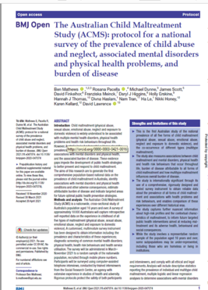

How we did the ACMS
Nationwide
cross-sectional
survey
8500
  Participants
  aged 16 and over
3500
  Informed by systematic review and analysis
  Computer-assisted telephone interviews
  Random sample
  of the population
  Adolescents/young adults aged 16-24
  Enables future Wave Studies, Cohort Study
5000
  Adults aged 25+
  1000 adults in 5 strata (25-34, 35-44, 45-54, 55-64, 65+)
  Enables measurement of health through life

Slide 6


Measuring the prevalence of child maltreatment
Each question had a Yes or No response
3
  Physical abuse (2, +1 on corp. punishment)
20
7
  Sexual abuse (5, +2 on the internet)
questions
3
  Emotional abuse
3
  Neglect
4
  Exposure to domestic violence

Slide 7


Exposure to domestic violence:
Item wording
Did you ever see or hear one of your parents get pushed, hit, choked, or beaten up by your other parent or their partner?
Did you ever see or hear one of your parents seriously threaten to hurt your other parent?
During an argument, did any of your parents ever damage any property or pets, punch the wall, or throw something?
Did you ever see or hear one of your parents intimidate or control your other parent, either verbally, sexually, financially, or by isolating them from friends or family?

Slide 8
Child maltreatment is disturbingly common
62%
of Australians have experienced 1 or more types of maltreatment
62%
65.5%
58.4%
Females
Males

Slide 9
We now know the prevalence of each type of child maltreatment in Australia
32%
28.5%
30.9%
8.9%
39.6%
Physical
abuse
Sexual
abuse
Emotional
abuse
Neglect
Exposure to domestic violence

Slide 10
Mental health disorders are far more common in those who experienced maltreatment
CM
NO CM
48%
21.6%
Almost half of all people who experienced child maltreatment have a mental disorder
Only one in five people who did not experience child maltreatment have a mental disorder

Slide 11
Prevalence of health risk behaviours, by experience of child maltreatment
Health risk behaviour | Experienced any child maltreatment |  | Odds ratio*
 | No (%) | Yes (%)
Smoking | 11.1 | 21.1 | 1.9
Binge drinking | 8.4 | 12.6 | 1.3
Cannabis dependence | 0.4 | 3.7 | 6.2*
Obesity | 24.4 | 28.2 | 1.2
Self-harm (prior year) | 0.7 | 4.7 | 3.9*
Suicide attempt (prior year) | 0.3 | 1.5 | 4.6*
  *Model adjusts for age group, sex, socio-economic status (quintiles of SEIFA index of relative disadvantage based on postcode of current residence), experience of financial hardship during childhood and current financial strain

Slide 12
Prevalence of child maltreatment among diverse sexuality and gender identities
Notes:
Specifically, we will be discussing the findings in those who identify as sexually diverse or gender diverse. The importance of discussing these results is due to that we found rates of child maltreatment to be highest among those with a diverse gender or sexuality. When we look at gender diverse individuals separate from sexually diverse, we found that …

Slide 13
Child maltreatment is disturbingly common among gender diverse individuals
81.5%
of gender diverse people experienced any child maltreatment
81.5%
65.5%
58.4%
Gender diverse
compared to 61.2%
(general population)
Cisgender females
Cisgender males
Notes:
81.5% of gender diverse Australians have experienced one or more types of child maltreatment at any time from birth to age 18. 81.5%. This is compared to 65.5% of cisgender women and 58.4% of cisgender men.
To give you a comparison to the general findings, the study found that 62% of all children had experienced maltreatment. So while this is still very high and a pressing issue in all individuals, we can see there is a large disparity between the abuse experienced among gender diverse people compared to cisgender people.
When we specifically looked at the gender diverse youth sample, that being 16–24-year-olds. The results show that 90.5% had experienced any child maltreatment. This further indicates the increasing prevalence among youth today and the importance of acting now.

Slide 14
Prevalence of each type of child maltreatment among gender diverse people in Australia
49.9%
51.9%
58.3%
26.4%
58.2%
Physical
abuse
Sexual
abuse
Emotional
abuse
Neglect
Exposure to domestic violence
cf. 32.0
cf. 28.5
cf. 30.9
cf. 8.9
cf. 39.6
Notes:
Of all gender diverse people – we broke down prevalence rates for all five types of child maltreatment.
Refer to slide.
As you can see, emotional abuse and exposure to domestic violence were the most prevalent – both sitting at around 58%.
When we look at the findings among sexually diverse people, we see very similar results…
Compare findings to general population **

Slide 15
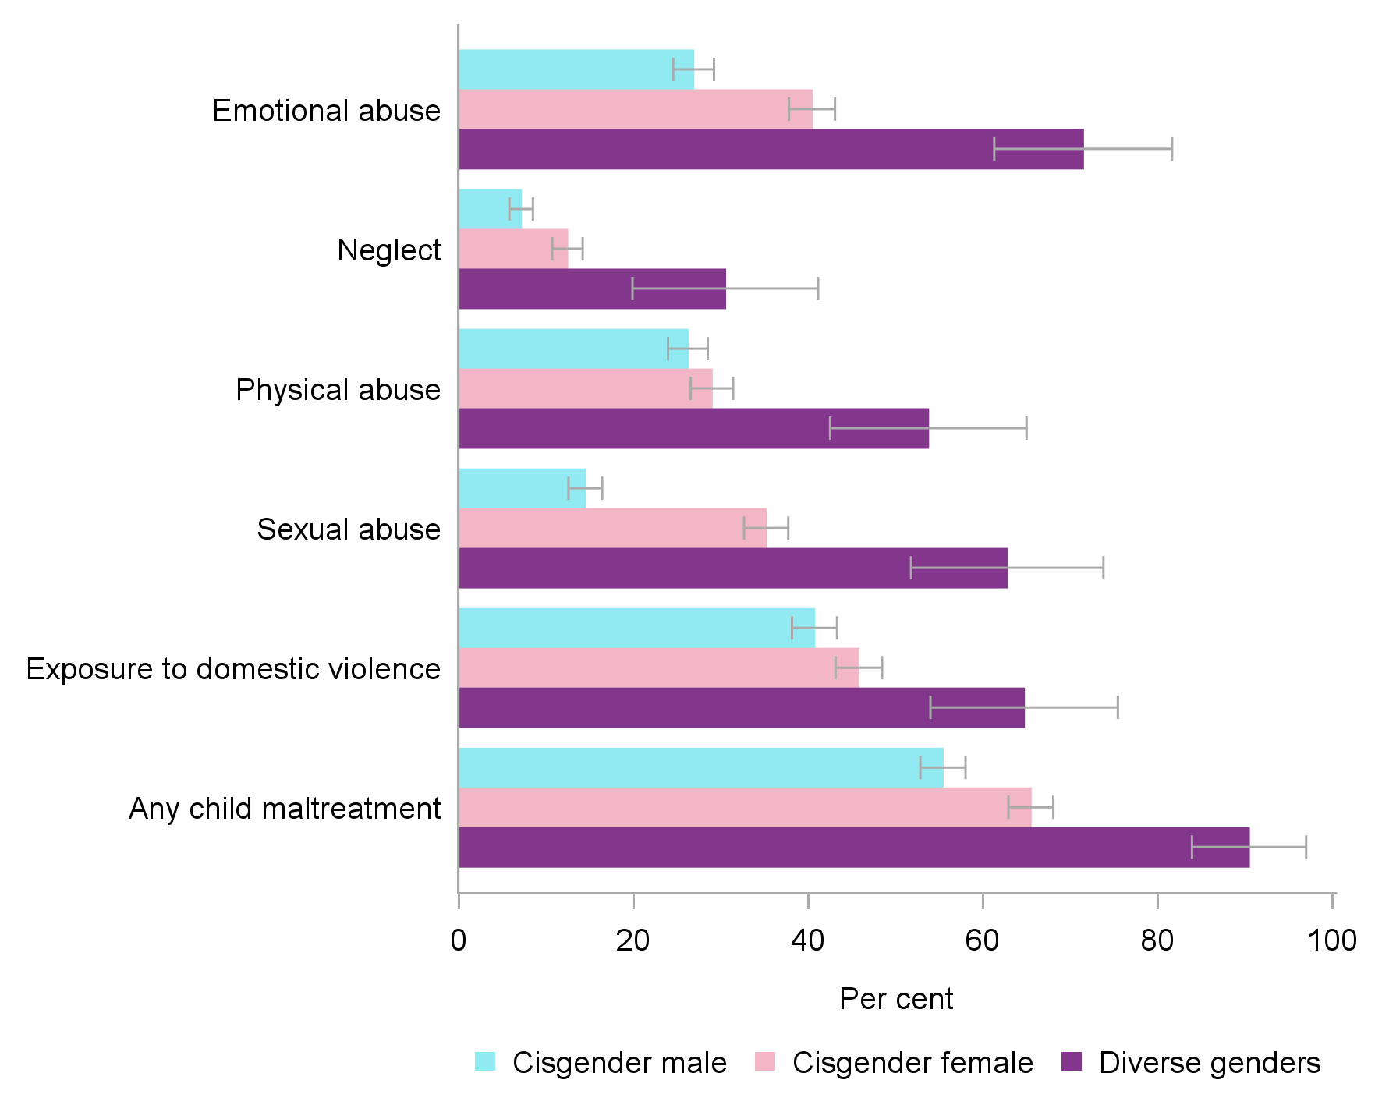
Prevalence of child maltreatment, by gender, 16-24 years
Notes:
When we did a breakdown by gender in younger people, gender diverse people are much more prone to experiencing all abuse types. Especially sexual abuse and emotional abuse. These are severe disparities
We found 90.5% experienced some form of child maltreatment and 77% had experienced multi-type maltreatment. This may imply that maltreatment amongst gender diverse youth is increasing.

Slide 16
Child maltreatment is disturbingly common among sexuality diverse individuals
83.9%
of sexuality diverse people experienced any child maltreatment type
83.9%
61.0%
35.8%
Sexuality diverse
Heterosexual or straight
Don’t know /refused
Notes:
Again, very similar patterns among those who identified as sexuality diverse, with 83.9% having experienced one or more type of child maltreatment.
This is compared to 61% of people who identify as heterosexual or straight.
Comment on don’t know/refusals *

Slide 17
Prevalence of each type of child maltreatment among sexuality diverse people in Australia
46.1%
52.6%
55.4%
19.3%
58.1%
Physical
abuse
Sexual
abuse
Emotional
abuse
Neglect
Exposure to domestic violence
cf. 32.0
cf. 28.5
cf. 30.9
cf. 8.9
cf. 39.6
Notes:
Of all sexuality diverse, there are similar prevalence estimates for all five types of child maltreatment, with EA and EDV still the most common.
So overall there is a slight difference between both, gender diverse and sexuality diverse, however there is quite a jump in neglect and physical abuse – which makes us question if this could be due to medical neglect.
Looking at the rates of child sexual abuse separately from the other maltreatment types, we can see that …

Slide 18
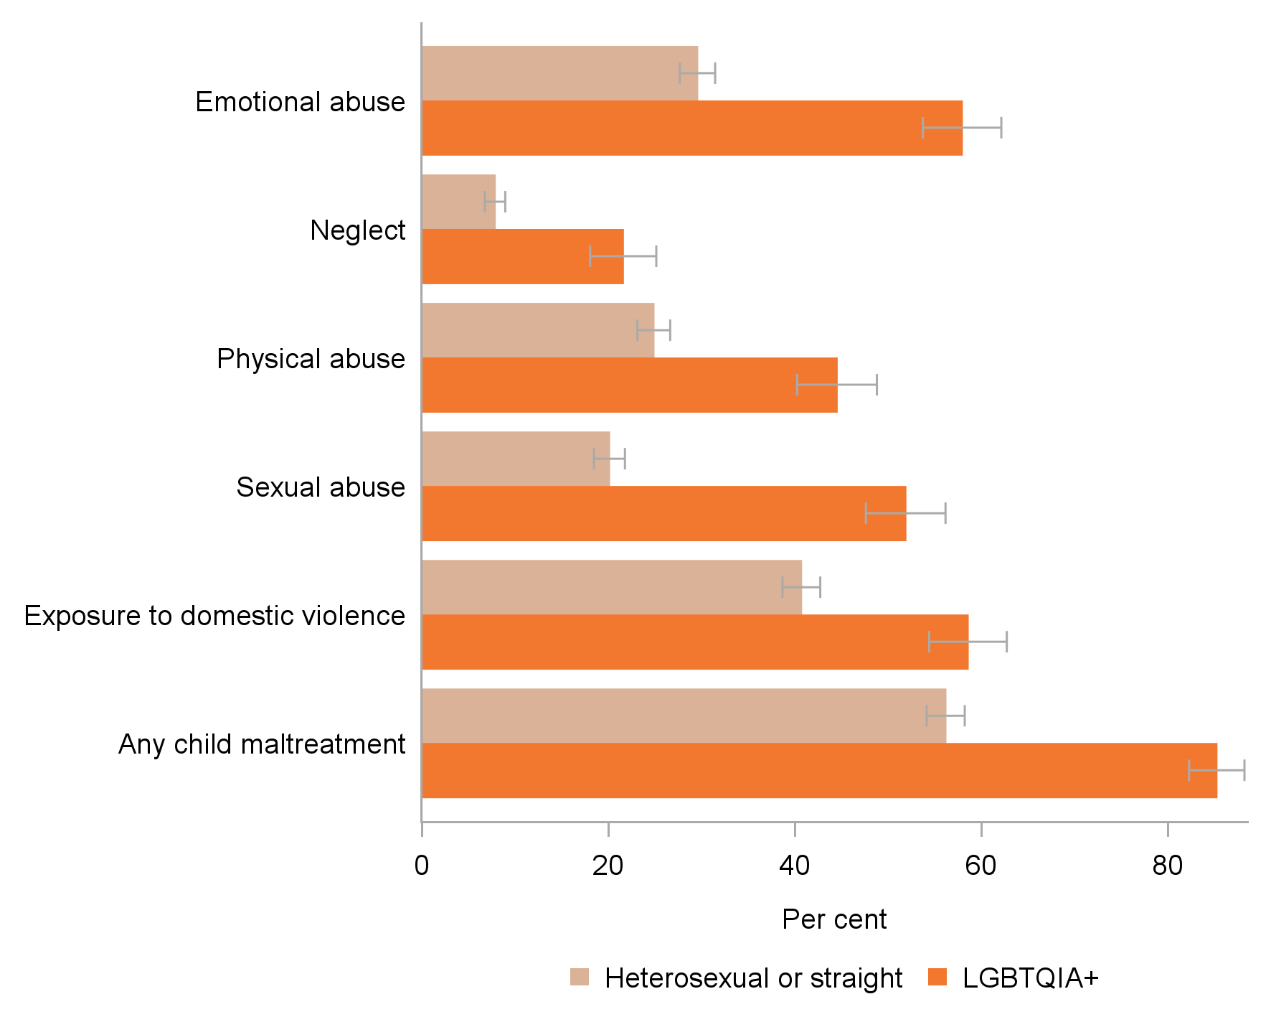
Prevalence of child maltreatment, by sexuality, 16-24 years
Notes:
This was also found true for maltreatment in the youth cohort with diverse sexualities (85.3% reporting any child maltreatment; 64.3% multi-type maltreatment).

Slide 19


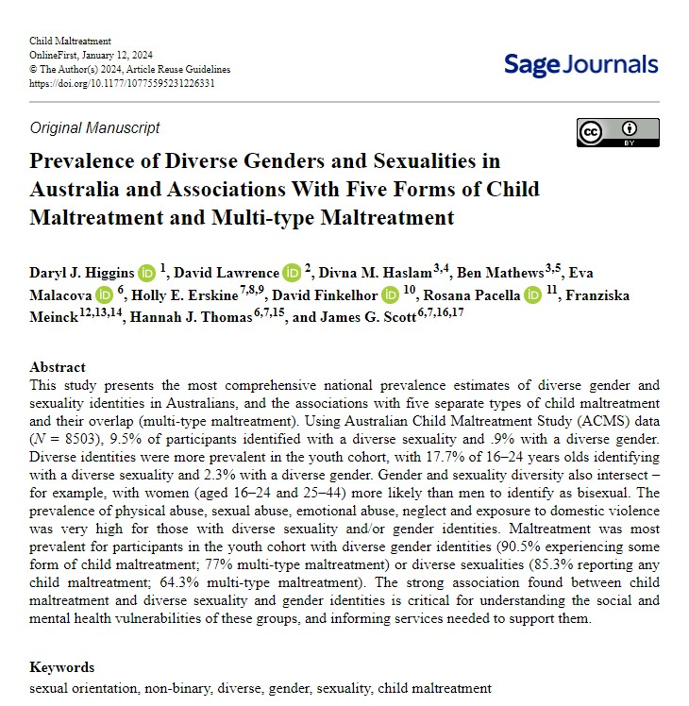
Diversity in genders and sexuality is increasing
…. and its association with child maltreatment
81.5% of those with a diverse gender (0.9% of Australians) experienced child maltreatment cf. 65.5% women and 58.4% of men
Youths (16-24) more likely to identify other than male/female (2.3%), and their likelihood of having experienced child maltreatment is even higher: 90.5%
83.9% of those who did not identify as heterosexual (9.5% of Australians) those identified as sexuality diverse experienced child maltreatment cf. 61% for heterosexual participants
Youths (16-24) more likely to identify other than heterosexual (17.7%), and their likelihood of having experienced child maltreatment is even higher: 85.3%
Knowledge about prevalence of gender and sexuality diversity and this strong association to child maltreatment needs to be integrated into prevention and response strategies including parenting skills and organisational child safeguarding strategies.
https://doi.org/10.1177/10775595231226331

Slide 20
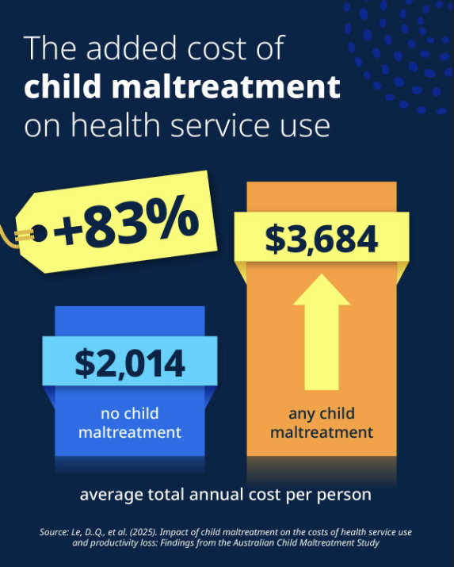
This paper explored the impact of child maltreatment on health costs and productivity in Australia, using the ACMS data. It showed:
🔹$1,670 higher healthcare costs per person each year for individuals who experienced child maltreatment than those who hadn't
🔹$21.6 billion in national health service costs annually
🔹$24.1 billion in productivity losses each year.
These findings highlight the significant long-term benefits that effective prevention and early intervention can have for individuals, communities and service systems.
Le et al. (2025),
https://authors.elsevier.com/sd/article/S0145-2134(25)00575-7

Slide 21
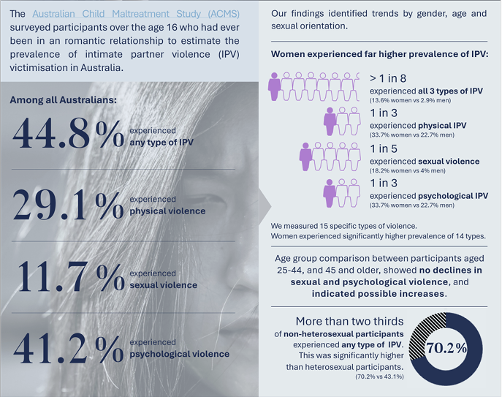
Prevalence of intimate partner violence victimisation in adulthood – national data from the ACMS
(Mathews et al., 2025)
http://dx.doi.org/10.5694/mja2.52660

Slide 22
Is child maltreatment associated with higher
risk of experiencing interpersonal violence (IPV) in adulthood?
Child maltreatment associated with more than double the odds of IPV:
56.8% of participants who experienced any type of child maltreatment experienced a type of IPV, compared to 24.4% who did not experience child maltreatment
The strongest odds for experiencing IPV was for those who experienced:
Childhood Sexual Abuse (1.9 times the odds)
Childhood Emotional Abuse (1.7 times the odds)
Multi-type child maltreatment, especially involving all three forms that involve direct acts of commission (sexual, emotional, and physical abuse), increased the likelihood of experiencing multi-type IPV.
Mathews, B., Do, H., Lawrence, D., Madzoska, M., Higgins, D., Scott, J., Cubitt, T., & Napier, S. (2025). Association between childhood maltreatment and adult intimate partner violence victimisation: Findings from a national survey in Australia. Journal of Interpersonal Violence, 1-39. https://doi.org/10.1177/08862605251398466

Slide 23
What other adversities coincide with childhood experiences of
domestic violence (EDV)?
Of the 39.6% of participants reporting childhood EDV:
one in five experienced all four forms of childhood EDV
Intimidation or control occurred over greater number of years, was more frequent and was more prevalent in mid-late adolescence cf. other forms of EDV
Intimidation or control was associated with the strongest odds for childhood emotional abuse (x 6 for men; x 3.3 for women).
All four other types of child maltreatment (sexual, physical, or emotional abuse, and neglect) and all other ACEs (except parental death) were substantially more common among those with EDV compared to those without.
Blake, J., Thomas, H. J., Mathews, B., Lawrence, D. M., Haslam, D. M., Higgins, D. J., Malacova, E., Erskine, H., & Scott, J. G. (2025). Experiences of domestic violence and other adversities in Australian children. Journal of Family Violence. https://doi.org/10.1007/s10896-025-00999-7

Slide 24
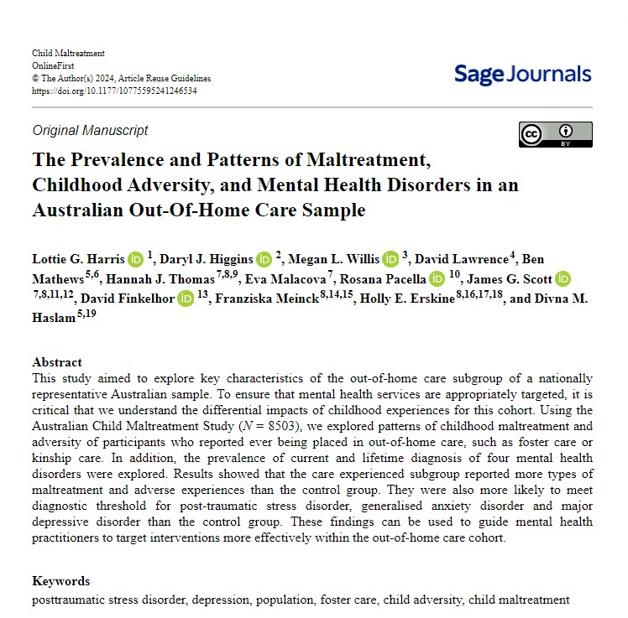

Out-of-home care
5.4% Of the 8503 participants, 395 had experienced a period of OOHC at some point during their childhood
91.5% Nine in 10 of those who were in OOHC experienced one or more types of childhood maltreatment cf. 60.6 % (6 in 10) of those who had not been in OOHC
79% Experienced 2 or more types of maltreatment (311) cf. 37% in the whole sample size
70.7% Experienced exposure to domestic violence c/w 39.6% in the whole sample size
More likely than the control group to meet diagnostic threshold for: post-traumatic stress disorder, generalised anxiety disorder, and major depressive disorder
https://doi.org/10.1177/10775595241246534

Slide 25
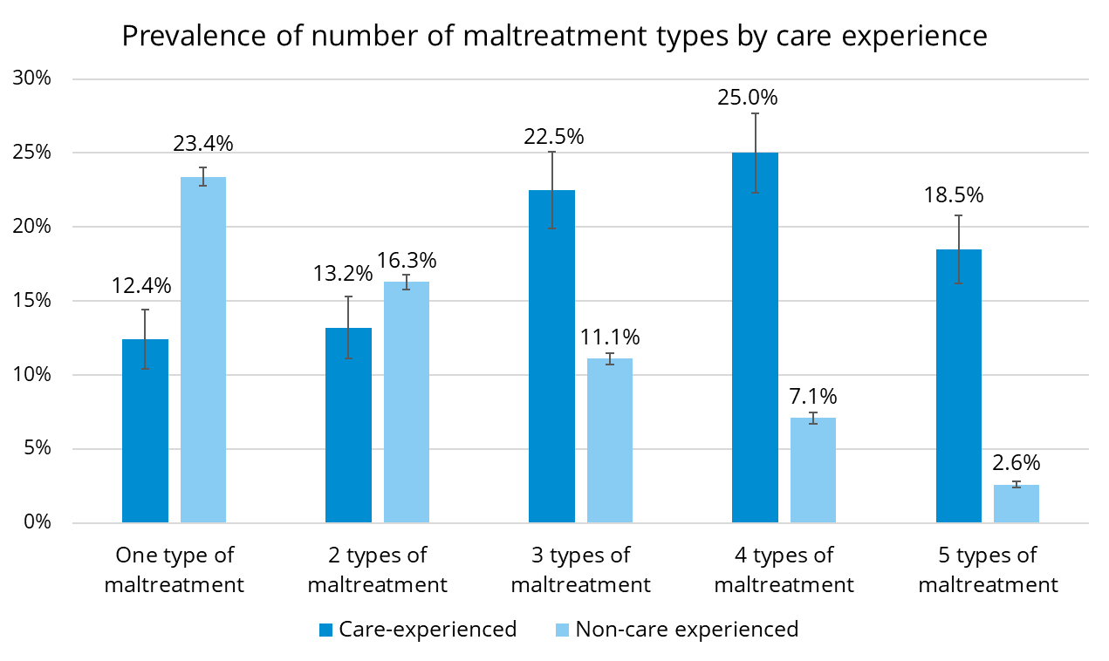


Slide 26
Nearly 3 in 10 Australian youth (29.1%) experienced problematic alcohol use
What is problematic alcohol use?
6+ drinks for males or 5+ drinks for females in a single session at least weekly in the past year
or being diagnosed with an alcohol use disorder

Slide 27


Rate of problematic alcohol use were highest among those exposed to multiple types of maltreatment
No maltreatment
23%
Single-type maltreatment
29%
Multi-type maltreatment
35%

Slide 28


55%
higher rate
Youth who experience multiple types of maltreatment have a 55% higher rate of problematic alcohol use compared with those who do not experience abuse

Slide 29

The rate of problematic alcohol use in youth who experienced
child sexual abuse
was 46% higher than in those who did not experience it
46%
higher rate

Slide 30
Non-maltreatment adversities in a child's environment were prevalent and associated with problematic alcohol use in youth

Slide 31

89%
of youth experienced at least one non-maltreatment adversity
27%
higher rate
Youth experiencing non-maltreatment adversities had a 27% higher rate of problematic alcohol use

Slide 32
Youth who experienced these specific adversities had significantly higher rates of problematic alcohol use than those who did not experience them:
56%
51%
higher rate
higher rate
Lived with someone with alcohol or drug use
Lived with someone with mental illness
44%
higher rate
Victim/witness of neighbourhood violence

Slide 33
2
Adversity accumulates… and it matters

Slide 34
Maltreatment is chronic, not isolated
Physical
abuse
Sexual
abuse
Emotional
abuse
Neglect
EDV
88% >1 time
62% >6 times
19% >50 times
78% >1 time
42% >6 times
11% >50 times
~80% >years
~75% >years
89% >1 time
65% >6 times
32% >50 times
Median:
9.5x
Median:
3.5x
Median:
years
Median:
years
Median:
11.8x

Slide 35
Prevalence of multi-type maltreatment
2 in 5
1 in 4
Australians have experienced multi-type maltreatment (2 or more types)
Almost 1 in 4 have experienced 3-5 types of maltreatment (23.3%)
39.4%
37.4%
22.8%
Any MTM
No CM
Single-type Maltreatment

Slide 36
Prevalence of multi-type maltreatment (youth aged 16-24)
2 in 5
1 in 4
Australians have experienced multi-type maltreatment (2 or more types)
young people have experienced 3-5 types of maltreatment (25.4%)
40.2%
38.8%
21.0%
Any MTM
No CM
Single Maltreatment

Slide 37
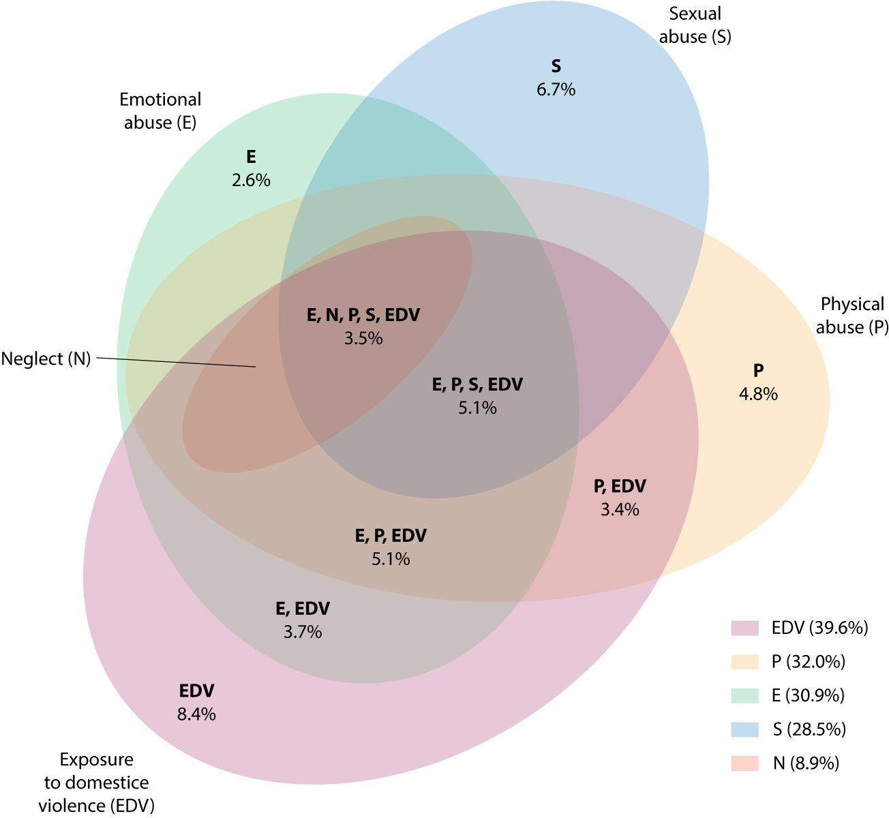
EDV is present
in the 5 most common types
of MTM…
…but is much rarer alone at 8.4%
EDV 8.4%

Slide 38

Family adversity increases risk of multi-type maltreatment
Childhood family-related risk factors associated with child maltreatment
 | Relative Risk | 95% Confidence Interval
Parental separation or divorce |  | 1.89 – 2.14
Living with someone who was mentally ill, suicidal or severely depressed |  | 2.28 – 2.57
Living with someone who had a problem with alcohol or drugs | 9.0% | 2.26 – 2.55
Family economic hardship |  | 2.06 – 2.32
Need supports for families to prevent multi-type maltreatment.
This evidence demonstrates the urgent need for evidence-based supports for parents and families, to reduce the likelihood of exposure to multiple types of maltreatment.
Services may need to be targeted to the needs of parents experiencing different kinds of vulnerabilities (such as poverty, addiction or mental illness) or at times of greater vulnerability (such as recent separation).
2.01
2.42
2.40
2.18

Slide 39
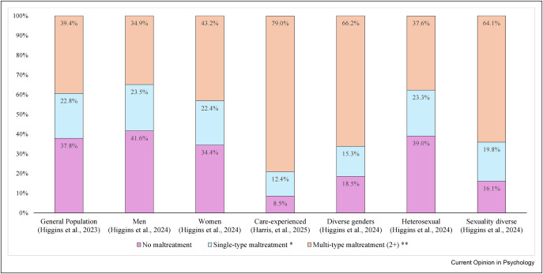
Prevalence of none, single-type, and multi-type maltreatment (ACMS)
https://doi.org/10.1016/j.copsyc.2025.102260

Slide 40
3
How can high prevalence drive prevention?

Slide 41






Higgins, D., Lonne, B., Scott, D., Herrenkohl, T. & Klika, B. (2022). Core Components of Public Health
Approaches to Preventing Child Abuse and Neglect. In R. Krugman, & J. Korbin, (Eds.) Handbook of Child Maltreatment
(Ch 22) 2nd Edition (Child Maltreatment: Contemporary Issues in Research and Policy, 14) (pp. 445-458). Springer.
https://link.springer.com/chapter/10.1007/978-3-030-82479-2_22
What to focus on
Address known risk factors for child abuse and neglect
6 core components
of a public health approach to child maltreatment prevention
Who to intervene with
Use whole-of-population strategies
When to intervene
Focus on early interventions & primary prevention
What works
Use efficacious, evidence-based approaches
Where to base delivery
Use non-stigmatising, accessible, and community-based platforms
What brings about change at scale
Use sustained—and sustainable—strategies to address structural determinants of child maltreatment and foster community mobilisation

Slide 42


Lessons from other public health campaigns
Tobacco-related lung cancer
RISK FACTORS
ENABLERS
GOAL
PROTECTIVE FACTORS
Take-up of smoking
Dose (heavy smoking)
Attitudes to smoking
Advertising
Brand packaging
Bans on smoking
Passive Smoking
Reduction/prevention of smoking
Parents/role models not smoking

Slide 43

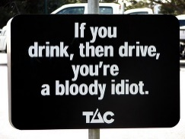
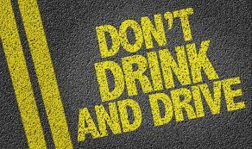
Lessons from other public health campaigns
Car and road safety
RISK FACTORS
ENABLERS
GOAL
PROTECTIVE FACTORS
Speeding
Drink driving
Community attitudes to alcohol & speeding
Designated drivers
Breath testing
Speed restrictions
Reduction in road accidents and fatalities
Car safety design
Road safety design

Slide 44




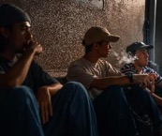
Implications based on ACMS key findings
Recognising lived experience
Past experiences of clients
Risk of further abuse/neglect
Childhood lived experiences of staff
2. Enabling mental health services to best support children, youth, and parents
Being trauma-informed, culturally aware
Being child-focused, rationally attuned
Being responsive to times of risk, particularly when parents are separating or struggling with their own experiences of mental ill health, substance misuse, economic hardship, or family violence.
Tailoring supports to these adversities
Working across silos, due to the high likelihood of children’s exposure to multiple harm types.

Slide 45



Implications
“Intensify primary and secondary prevention
through a precision public health model,
informed by the evidence.”
3. Enabling primary prevention workforces
activate community attitude change (to value children, uphold their rights, & prioritise safety).
deploy evidence-based supports to improve parenting skills and provide safe environments for children and young people.
build capacity of parents/carers to create safety in the family, by adapt child-safe organisations strategies for the home. e.g.,:
    ‘assess’ the suitability of others to care safely
    manage situational risks (places, people, activities)
    equip children with knowledge about sexuality and skills regarding consent and respect
    listen & respond to all safety concerns – including harmful sexual behaviour from other children.

Slide 46
Call for a National Summit on Child Maltreatment Prevention
We invite you to join this call.
A Summit will bring people together in a new way to:
Bring decision and policy makers from across governments and portfolios into the same room.
Learn from experts, academics, people working with children and families, and individuals with lived experiences
from across the community.
Build a common understanding of what we already know about child abuse and neglect.
Talk openly and honestly about what is working and not working (and where the money is going and needs to go).
Explore the evidence on the root causes of maltreatment and find smarter solutions to prevent abuse.
Establish prevention of abuse as a national and whole-of-community priority.
The goal must be to ensure that as many children as possible grow up loved, safe and well in their families.
https://www.napcan.org.au/national-summit-to-prevent-child-maltreatment/

Slide 47

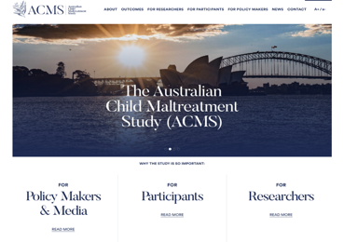
https://www.acms.au
Further information on implications:
MJA Insight: https://insightplus.mja.com.au/2023/11/australian-child-maltreatment-study-the-shocking-findings/
MJA Podcasts: https://www.mja.com.au/podcast/218/6/mja-podcasts-2023-episode-1-australian-child-maltreatment-study-prof-david-Lawrence
The Conversation: https://theconversation.com/major-study-reveals-two-thirds-of-people-who-suffer-childhood-maltreatment-suffer-more-than-one-kind-202033
Resources for child-centred questions: https://www.acu.edu.au/about-acu/institutes-academies-and-centres/institute-of-child-protection-studies/kids-central-toolkit

Slide 48
Institute of Child Protection Studies (ICPS)
A nationally recognised centre of research excellence in the field of child, youth and family welfare.
Professor Daryl Higgins
Director – Institute of Child Protection Studies (ICPS)
Australian Catholic University
Melbourne Campus
T +61 (0)3 9953 3607 M 0425 795 303
E daryl.higgins@acu.edu.au
W www.acu.edu.au/icps

